Slide 1

Chapter 9: INTRODUCTION TO DIFFERENTIAL EQUATIONS
Contents:
9.1 Solving Differential Equations
9.2 Models Involving $y′$ = k(y − b)
9.3 Graphical and Numerical Methods
9.4 The Logistic Equation
9.5 First-Order Linear Equations

Slide 2

9.1 Solving Differential Equations (1 of 23)
A differential equation is an equation that involves an unknown function and its first or higher derivatives. The following differential equations are among the ones that we will consider at various points in this chapter:
$$\frac{dy}{dx}=1−6e^{2x}, \frac{dP}{dt}=rP−N, \frac{dy}{dt}+\frac{1}{t+30}y=4$$
The order of a differential equation is the highest order derivative that appears in the equation. In this chapter, we restrict our attention to first-order differential equations. A solution to a differential equation is a function that satisfies the equation, and a primary goal when working with a differential equation is to find the solutions. The next example considers a simple differential equation like the ones we considered in Section 5.3.

Slide 3

9.1 Solving Differential Equations (2 of 23)
EXAMPLE: Consider the differential equation $\frac{dy}{dx}=1−6e^{2x}$.
Find the solutions.
Find the solution satisfying y(0) = 5.
Solution
a) The form of the differential equation enables us to solve it directly by antidifferentiation:
$$y=\int{\left(1−6e^{2x}\right)dx}=x−3e^{2x}+C$$
b) To satisfy y(0) = 5, we must have 5 = 0 − 3e⁰ + C. Therefore, C = 8. So the function y(x) = x − 3e^{2x} + 8 satisfies the differential equation and the condition y(0) = 5.

Slide 4
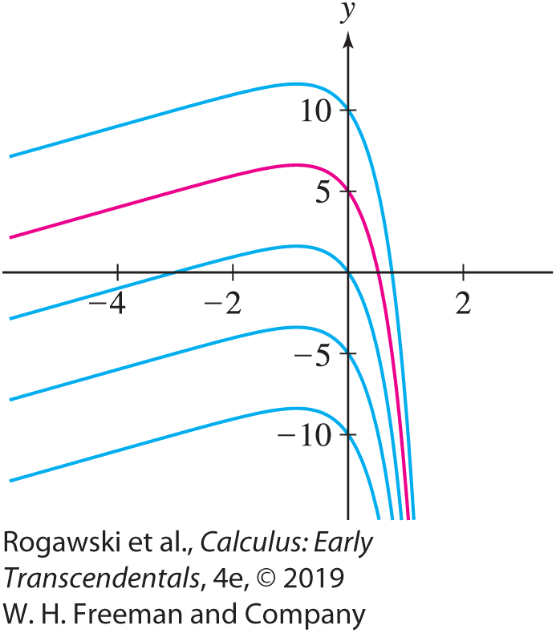

9.1 Solving Differential Equations (3 of 23)
Generally, a differential equation has a family of solutions. The solutions to the differential equation $\frac{dy}{dx}=1−6e^{2x}$in the last example are the functions y(x) = x − 3e^{2x} + C. The graphs of these solutions form a collection of curves in the xy-plane (Figure 1).

Slide 5

9.1 Solving Differential Equations (4 of 23)
An expression for the family of solutions to a differential equation, such as y(x) = x − 3e^{2x} + C, is called a general solution.
For each value of C in the general solution, we obtain a particular solution. The function y(x) = x − 3e^{2x}+ 8 is the particular solution to $\frac{dy}{dx}=1−6e^{2x}$satisfying y(0) = 5.
A condition y(x₀) = y₀ for identifying a particular solution is called an initial condition.
A problem consisting of a differential equation and an initial condition is called an Initial Value Problem.

Slide 6

9.1 Solving Differential Equations (5 of 23)
A differential equation is called separable if it can be written in the form
$$\frac{dy}{dx}=f\left(x\right)g\left(y\right)$$
For example,
$\frac{dy}{dx}$= y sin x and $\frac{dy}{dx}$= x + xy are separable.
$\frac{dy}{dx}$= x + y is not separable because x + y is not a product f (x )g(y).

Slide 7

9.1 Solving Differential Equations (6 of 23)
Separable equations are solved using the method of Separation of Variables: Move the terms involving y to the left and those involving x to the right. Then set up integrals and evaluate:
$$\frac{dy}{dx}=f\left(x\right)g(y)$$
$$\frac{1}{g(y)}dy=f\left(x\right)dx$$
$$\int{\frac{1}{g(y)}dy}=\int{f\left(x\right)dx}$$
EXAMPLE: Find the general solution to $\frac{dy}{dx}=$ 6xy² and the particular solution satisfying y(0) = –1.

Slide 8
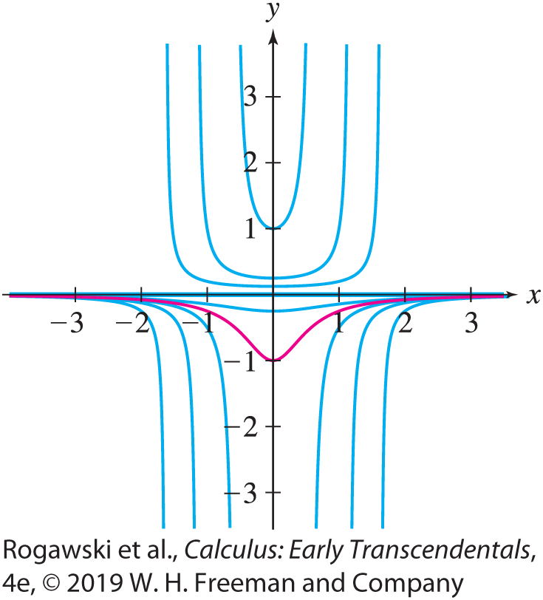

9.1 Solving Differential Equations (7 of 23)
Solution First, we observe that y(x) = 0 is a solution to the differential equation. Then, assuming y ≠ 0, we use Separation of Variables as follows: $y^{−2}dy=6xdx$ from which we get $\int{y^{−2}dy}=\int{6xdx}$. Integrating yields $−y^{−1}=3x^{2}+C.$ Hence, $y=\frac{−1}{3x^{2}+ C}.$ Thus, the general solution to $\frac{dy}{dx}=$ 6xy² consists of the functions y(x) = 0 and $y=\frac{−1}{3x^{2}+ C}$. This family of solutions is sketched in Figure 2, and the particular solution satisfying the initial condition y(0) = −1 is highlighted. To find the particular solution satisfying y(0) = −1, we set x = 0 and y = −1 in the general solution and solve for C: $−1=\frac{−1}{0 + C}$ from which we obtain C = 1. Thus, the particular solution satisfying the given initial condition is $y=\frac{−1}{3x^{2}+ 1}.$

Slide 9
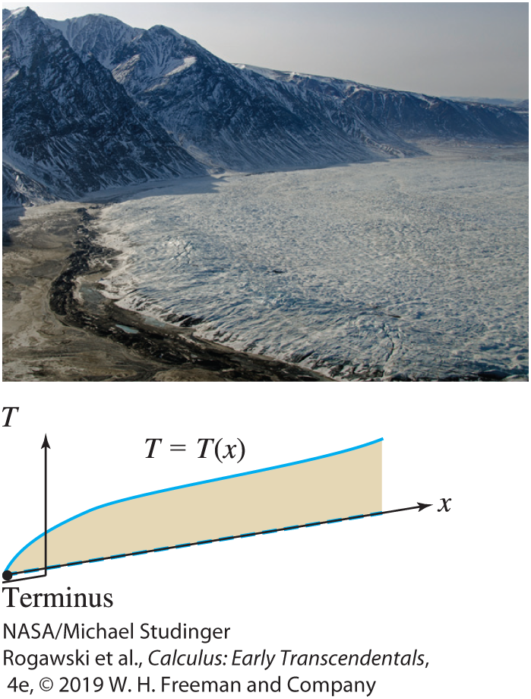

9.1 Solving Differential Equations (8 of 23)
In the field of glaciology, a simple separable differential equation is used to model a glacier’s thickness, the vertical distance from its surface to its base (Figure 3). A glacier is a river of ice, and like a river of water, it flows (but does so relatively slowly). Mass is added to a glacier by precipitation and is lost by sublimation, evaporation, and meltwater runoff. We assume that the amount of mass lost equals the amount that is gained, and therefore the glacier’s shape does not change. We model the glacier’s thickness by T (x), where x is the distance in meters from the front of the glacier (the location where the glacier ends on land or water, also known as the terminus).
$$T\frac{dT}{dx}=\frac{τ}{ρg}$$
In the equation, τ is the friction at the base of the glacier,
ρ is the ice density, and g is acceleration due to gravity.

Slide 10

9.1 Solving Differential Equations (9 of 23)
EXAMPLE: A Glacial Thickness Model Let g = 9.8 m/s², τ = 75,000 N/m², and ρ = 917 kg/m³. Use T (0) = 0 for an initial condition, and solve for T (x). Then use T (x) to determine the thickness of the glacier 1 km from its terminus.
Solution The differential equation that we need to solve is $T\frac{dT}{dx}=\frac{75,000}{917 ∙ 9.8}=8.35.$
It is a separable differential equation. We proceed as follows:
$\int{Tdt}=\int{8.35dx}$.
Integrating, we obtain $\frac{1}{2}T^{2}=8.35x+C$or $T=\sqrt{16.7x+C}.$
We have $0=T\left(0\right)=\sqrt{C}$ and $T(x)=\sqrt{16.7x}$.
At a distance of 1 km from the terminus, the thickness is T (1000) = $\sqrt{16,700}=129 m.$

Slide 11
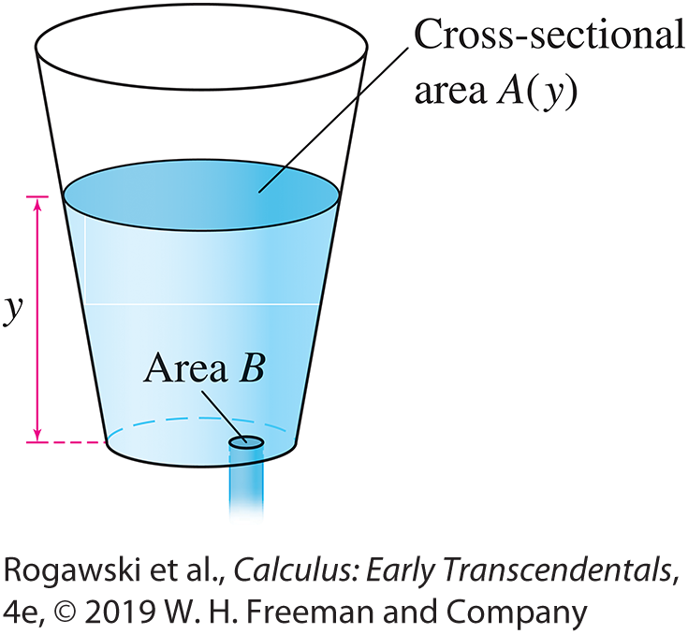

9.1 Solving Differential Equations (10 of 23)
Another model that results in a separable differential equation involves the water level in a container that has a leak through a hole in the bottom (Figure 5). We let y(t) be the height of water in the container as a function of time, A(y) be the cross-sectional area of the container at height y, and B be the area of the hole in the bottom of the container. In our model, we assume the volume in the container that is lost equals the volume that flows out, and we apply an important fluid-flow law known as Torricelli’s Law.
We obtain the following differential equation:
$$\frac{dy}{dt}=−\frac{B\sqrt{2gy}}{A\left(y\right)} (3)$$
In the equation, g is acceleration due to gravity.

Slide 12
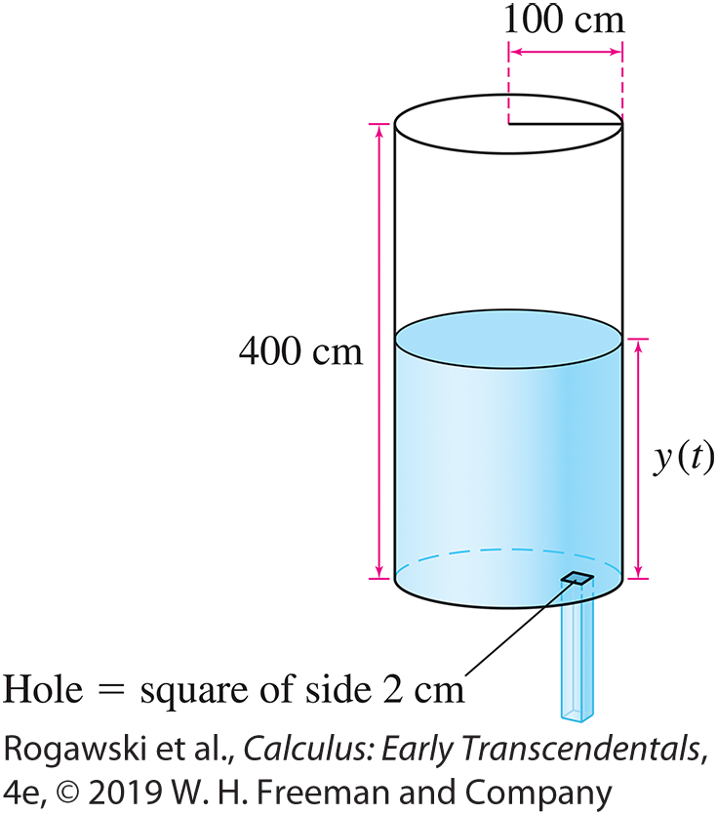

9.1 Solving Differential Equations (11 of 23)
EXAMPLE: A cylindrical container of height 400 cm and radius 100 cm is filled with water. In the bottom of the container is a square hole of side length 2 cm through which water leaks. Determine the water level y(t) in centimeters as a function of time t in seconds. How long does it take for the tank to go from full to empty?
Solution The horizontal cross section of the cylinder is a circle of radius r = 100 cm and area A(y) = πr ² = 10,000π cm² (Figure 6).
The hole has area B = 4 cm². With the units we are employing,
we set g = 980 cm/s². Now, Eq. (3) becomes
$$\frac{dy}{dt}=−\frac{4\sqrt{1960y}}{10,000π}≈−0.0056\sqrt{y}$$

Slide 13
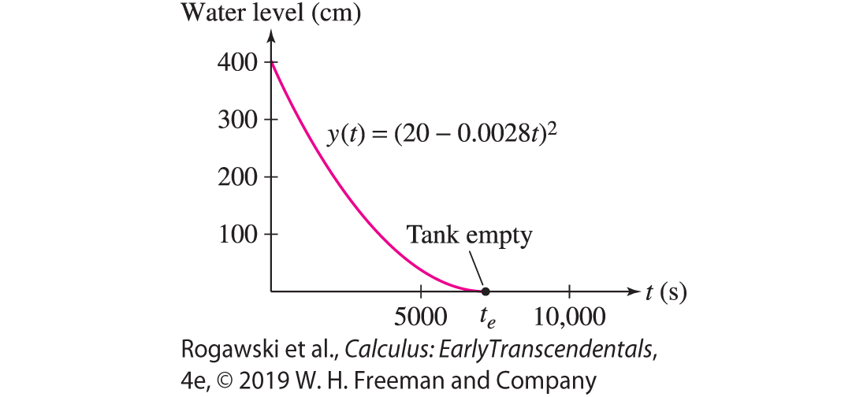

9.1 Solving Differential Equations (12 of 23)
Since the tank is full at t = 0, we have the initial condition y(0) = 400.
Now, y(t) = 0 is a solution to the differential equation, but it does not satisfy the initial condition. We assume y ≠ 0 and solve using Separation of Variables:
$\int{\frac{dy}{\sqrt{y}}}=\int{− 0.0056dt}$ which yields $2y^{1/2}=C−0.0056t$.
At this point, rather than solving for general y(t), it is convenient to determine the value of C for which the initial condition is satisfied. Substituting y = 400 and t = 0 into Eq. (5), we obtain C = 40. Thus, we have $2y^{1/2}=40−0.0056t$ or $y={\left(20−0.0028t\right)}^{2}.$
To determine the time t_{e} that it takes to empty the tank, we solve
$0=y(t_{e})$ or $20=0.0028t_{e}$. Hence, $t_{e}≈7142 s$. The tank is
empty after 7142 s, or nearly 2 hours (Figure 7).

Slide 14

9.1 Solving Differential Equations (13 of 23)
Note that the solution y(t) = (20 − 0.0028t)² in the previous example is valid only for 0 ≤ t ≤ t_{e}. For t > t_{e}, the function y(t) = (20 − 0.0028t)² does not satisfy the differential equation; it is increasing while the differential equation requires that $\frac{dy}{dt}$ ≤ 0 for all t. This “extraneous solution” (for t > t_{e}) arose as a result of squaring both sides of Eq. (6). It is clear physically that after the tank empties, y(t) = 0 for all t . Mathematically, it also works to extend the solution so that y(t) = 0 for t ≥ t_{e} because y(t) = 0 also satisfies the differential equation. Thus, the solution to the Initial Value Problem, defined for all t ≥ 0, is
$$y\left(t\right)=\left\{\begin{aligned}\begin{matrix}\text{(}\text{2}\text{0} \text{−} \text{0.0028}\text{t}\text{)}\text{2} & \text{for} \text{0} \text{≤} \text{t} \text{≤} \text{t}\text{e}\text{2}\end{matrix} \\ \begin{matrix}0 & \text{for} \text{t} \text{≥} \text{t}\text{e}\end{matrix}\end{aligned}\right.$$

Slide 15

9.1 Solving Differential Equations (14 of 23)
Many phenomena are modeled by the differential equation
$\frac{dy}{dt}$= ky
which assumes that
The rate of change of y is proportional to the amount of y present.
Examples include the growth of a population, the spread of a computer virus, the decay of a radioactive substance, and the elimination of a drug from a patient’s bloodstream. For “growth” and “spread,” the proportionality constant k in the differential equation is positive (y would be increasing); for “decay” and “elimination,” it is negative.

Slide 16
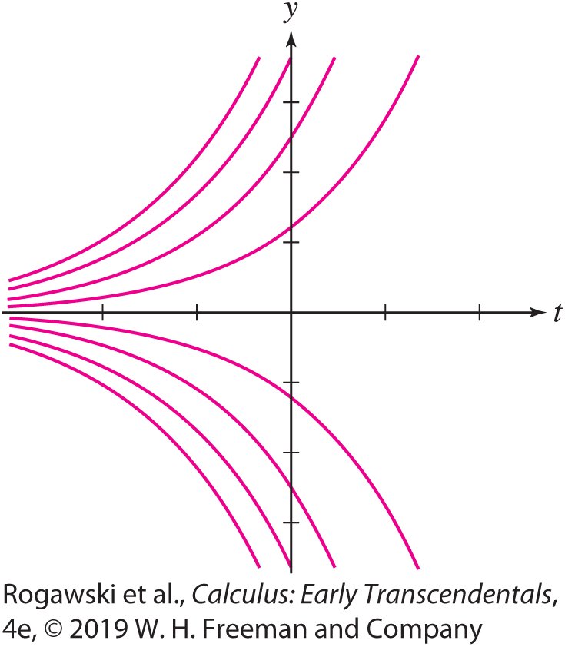

9.1 Solving Differential Equations (15 of 23)
EXAMPLE: Find the general solution to $\frac{dy}{dt}$ = ky.
Solution First, note that y(t) = 0 is a solution to the differential equation. Then, assuming y ≠ 0, we employ Separation of Variables:
$\frac{dy}{y}=kdt$ or $\int{\frac{dy}{y}}=\int{kdt}$
Hence, $\ln{|y|}=kt+C$ or $\left|y\right|=e^{kt+C}$. We can rewrite the last equation, which yields $y=De^{kt}$as the general solution of $\frac{dy}{dt}=ky$ because we can choose D to be positive or negative or D = 0.

Slide 17
9.1 Solving Differential Equations (16 of 23)
The function y = De^{kt} models exponential growth when k > 0, and it models exponential decay when k < 0. For a simple population growth model, it is natural to assume that the rate of growth of the population is proportional to the population present because we expect some fixed percentage of all individuals will contribute to reproduction.
EXAMPLE: Escherichia coli bacteria grows such that the rate of change of the population is proportional to the population present. Assume that 1000 bacteria are initially present, and 1500 are present after one hour.
Determine P(t), the population after t hours.
How large is the population after 5 h?
How long does it take for the population to double in size?

Slide 18

9.1 Solving Differential Equations (17 of 23)
Solution Since the rate of change $P′$(t) is proportional to P(t), we have the differential equation $P′$(t ) = kP(t ). Furthermore, we are given the initial conditions P(0) = 1000 and P(1) = 1500. Together, the differential equation and initial conditions make up the Initial Value Problem that we must solve.
Note that we have two initial conditions. Both are necessary because we need to determine the constant term D in the general solution to the differential equation and the term k in the differential equation itself.
The general solution to the differential equation is P(t) = De^{kt} , and the initial condition
P(0) = 1000 implies that D = 1000. Thus, the solution is in the form P(t) = 1000e^{kt}.

Slide 19
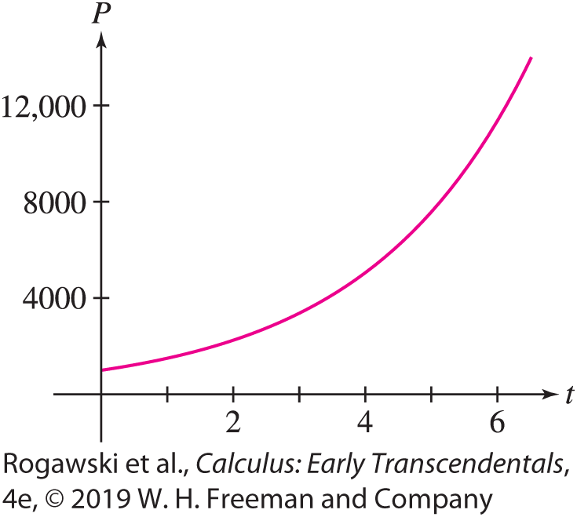
9.1 Solving Differential Equations (18 of 23)
To determine k, we substitute P = 1500 and t = 1 into P(t) = 1000e^{kt} and solve for k:
1500 = 1000e^{k}
1.5 = e^{k}
ln 1.5 = k
k ≈ 0.405
Therefore, with an approximate value for k,
we have that P(t) = 1000e^{0.405t} (Figure 9).

Slide 20

9.1 Solving Differential Equations (19 of 23)
After 5 h, the population is P(5) = 1000e^{0.405(5)} ≈ 7576 bacteria.
To determine when the population doubles, we find t such that P = 2000:
2000 = 1000e^{0.405t}
2 = e^{0.405t}
ln 2 = 0.405t
t = $\frac{\ln{2}}{0.405}$≈ 1.71 h

Slide 21

9.1 Solving Differential Equations (20 of 23)
In the previous example, we computed the time it takes for the initial population to double. In exponential growth, the time to double in size is called the doubling time. Similarly, in exponential decay, the half-life is the time it takes for an initial amount to decrease to half its size. Doubling time and half-life do not depend on the initial amount, but depend only on the value of the term k, as follows:
Half-life and Doubling Time for P(t ) = P₀e^{kt}
Exponential decay: k < 0 half-life = $\frac{\ln{0.5}}{k}$
Exponential growth: k > 0 doubling time = $\frac{\ln{2}}{k}$
It is straightforward to verify these formulas using the computations from the last example.

Slide 22

9.1 Solving Differential Equations (21 of 23)
EXAMPLE: A patient is administered 400 mg of penicillin, and after 50 minutes, 300 mg remains in her bloodstream. Let A(t) represent the amount of penicillin (in milligrams) in her bloodstream t minutes after the drug was administered. Assume that the drug is leaving her bloodstream at a rate proportional to the amount in her bloodstream. Determine A(t) and the half-life of the resulting exponential decay.
Solution
Since the rate of change is proportional to the amount present, $A′$(t) = k A(t). Furthermore, we are given the initial conditions A(0) = 400 and A(50) = 300, and therefore we have an Initial Value Problem that we must solve.
The general solution to the differential equation is A(t) = De^{kt} , and the initial condition A(0) = 400 implies that D = 400. The solution is therefore in the form A(t) = 400e^{kt} .

Slide 23
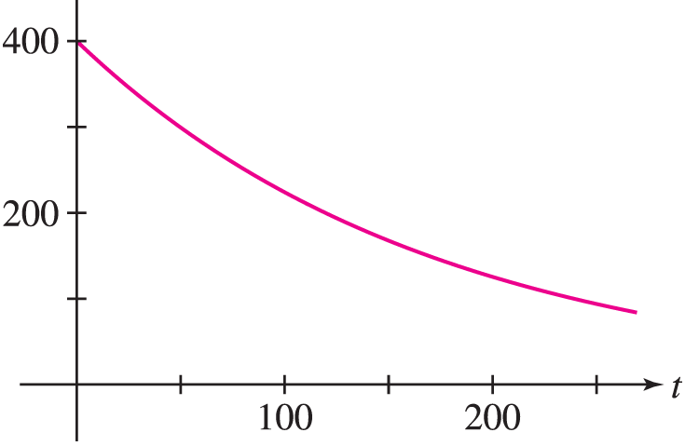

9.1 Solving Differential Equations (22 of 23)
To determine k, we substitute A = 300 and t = 50 into A(t) = 400e^{kt} and solve for k:
300 = 400e^{50k}
0.75 = e^{50k}
ln 0.75 = 50k
$$k=\frac{\ln{0.75}}{50}\text{≈} \text{−}\text{0.0058}$$
Thus, with this approximate value for k, we have that
A(t) = 400e^{−0.0058t} (Figure 10).
The half-life is $\frac{\ln{0.5}}{k}=\frac{\ln{0.05}}{\text{−}\text{0.0058}}≈120 min.$

Slide 24

9.1 Solving Differential Equations (23 of 23)
If an Initial Value Problem models a physical relationship, we would want to know whether or not a solution exists and whether or not the solution is unique. Having no solution suggests that the model is not correct. Perhaps we would need to reevaluate the assumptions used to build the model. Having a unique solution would be desirable if we expect the phenomenon to change in only one way and we wish to make predictions.
Note that the Initial Value Problem, $\frac{dy}{dt}$ = ky and y(0) = y, has the solution $y=y_{0}e^{kt}$ [obtained from Eq. (2) using the initial condition y(0) = y₀]. It is the only solution that is provided by the general solution formula. We can prove that this solution is unique by showing that all solutions to the differential equation are provided by the general solution (see Exercise 61).

Slide 25

9.2 Models Involving $y′$ = k(y − b) (1 of 15)
In this section, we examine the differential equation
$$\frac{dy}{dt}=\text{k}\text{(}\text{y}\text{ − }\text{b}\text{)} \text{(1)}$$ where k and b are constants. This differential equation describes a quantity y whose rate of change is proportional to the difference y − b. It arises in many different modeling situations. We will use it to model a cooling object in a fixed-temperature environment, vertical motion under the influence of gravity and air resistance, and the changing value of an annuity.
This differential equation can be written in the form $\frac{dy}{dt}=\text{k}\text{ + }\text{c}\text{,}$ and is called linear because the relationship between $\frac{dy}{dt}$ and y is linear.

Slide 26

9.2 Models Involving $y′$ = k(y − b) (2 of 15)
Furthermore, because the coefficient k and the term c are constant, the differential equation is said to have constant coefficients. Thus, the differential equations we examine in this section are first-order linear constant coefficient differential equations. In Section 9.5, we examine the general first-order linear differential equation where the terms k and c could be functions of t.
We can use Separation of Variables to show that the general solution to Eq. (1) is
$$y=b+Ce^{kt} (2)$$
Alternatively, we may observe that ${\left(y−b\right)}^{′}=y′$ since b is a constant, so Eq. (1) may be rewritten as
$$\frac{d}{dt}\left(y−b\right)=k\left(y−b\right)$$
In other words, y − b satisfies the differential equation of an exponential function and thus y − b = Ce^{kt} , or y = b + Ce^{kt} , as claimed.

Slide 27

9.2 Models Involving $y′$ = k(y − b) (3 of 15)
We now consider some applications of Eq. (1), beginning with Newton’s Law of Cooling. Let y(t) be the temperature of a hot object that is cooling off in an environment where the ambient temperature is T₀. Newton assumed that the rate of cooling is proportional to the temperature difference y − T₀. We express this hypothesis in a precise way by the differential equation
$y′$ = −k(y − T₀) (T₀ = ambient temperature)
The constant k, in units of (time)⁻¹, is called the cooling constant and depends on the physical properties of the object.

Slide 28

9.2 Models Involving $y′$ = k(y − b) (4 of 15)
EXAMPLE: Newton’s Law of Cooling A hot metal bar with cooling constant
k = 2.1 min⁻¹ is submerged in a large tank of water held at temperature T₀ = 10°C. Let y(t)
be the bar’s temperature at time t (in minutes).
Find the differential equation satisfied by y(t) and find its general solution.
What is the bar’s temperature after 1 min if its initial temperature was 180°C?
What was the bar’s initial temperature if it cooled to 80°C in 30 seconds?
Solution a) Since k = 2.1 min⁻¹, y(t) (with t in minutes) satisfies
$y′$ = −2.1(y − 10)
By Eq. (2), the general solution is y(t) = 10 + Ce^{−2.1t} for some constant C.

Slide 29
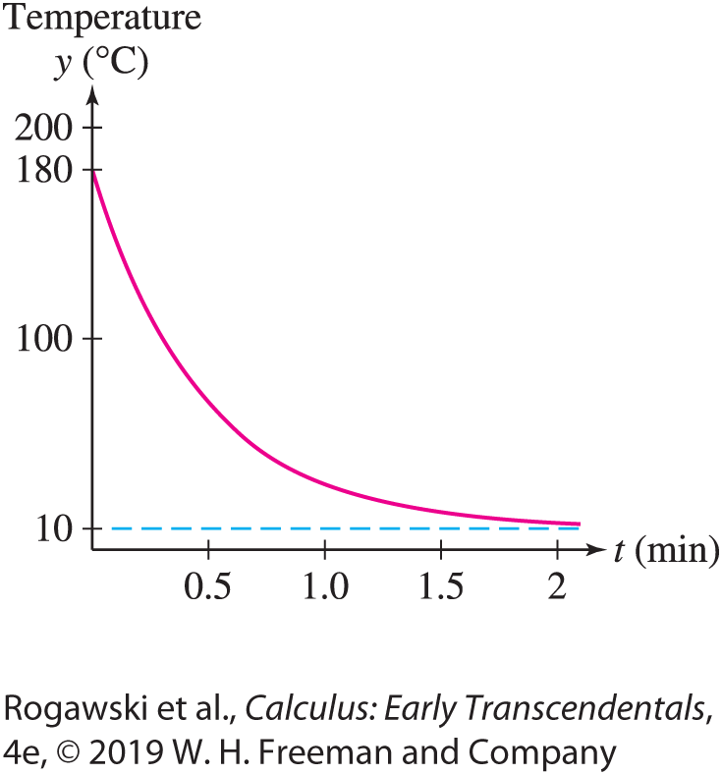
9.2 Models Involving $y′$ = k(y − b) (5 of 15)
b) If the initial temperature was 180°C, then y(0) = 10 + C = 180. Thus, C = 170 and
y(t) = 10 + 170e^{−2.1t} (Figure 2). After 1 min,
y(1) = 10 + 170e^{−2.1(1)} ≈ 30.8°C
c) If the temperature after 30 s is 80°C, then y(0.5) = 80, and we have
10 + Ce^{−2.1(0.5)} = 80
Ce^{−1.05} = 70
C = 70e^{1.05} ≈ 200
It follows that y(t ) = 10 + 200e^{−2.1t} and the initial temperature was
y(0) = 10 + 200e^{−2.1(0)} = 10 + 200 = 210°C

Slide 30

9.2 Models Involving $y′$ = k(y − b) (6 of 15)
The differential equation $y′$ = k(y − b) is also used to model vertical motion near the surface of the earth when air resistance is taken into account. Assume that the force due to air resistance is proportional to the velocity v and acts opposite to the direction of motion. We write this force as −kv, where k > 0. We take the upward direction to be positive, so v< 0 for a falling object and −kv is an upward acting force, while v> 0 for a rising object and −kv is a downward acting force.
The force due to gravity on an object of mass m is −mg, where g is the acceleration due to gravity, so the total force is F = −mg − kv. By Newton’s Second Law of Motion,
F = ma = m$v′$ (a = $v′$ is the acceleration and m is the mass) Thus, m$v′$ = −mg − kv, which can be written as
$$v^{′}=−\frac{k}{m}\left(v+\frac{mg}{k}\right)$$

Slide 31

9.2 Models Involving $y′$ = k(y − b) (7 of 15)
This equation corresponds the standard form $y′$ = −k(v − b), with k being replaced by k/m and b = −mg/ k. By Eq. (2), the general solution is
$$v(t)=−\frac{mg}{k}+Ce^{−\left(k/m\right)t} (4)$$
Since Ce^{−(k/m)t} tends to zero as t → ∞, v(t) tends to a limiting terminal velocity:
terminal velocity = $\lim_{t→∞}{v(t)}=−\frac{mg}{b}$
Without air resistance, the speed (absolute value of velocity) of a falling object would increase without bound until a sudden collision with the ground occurs. On the other hand, with air resistance the speed also increases, but levels off and approaches a limiting value of mg/ k.

Slide 32

9.2 Models Involving $y′$ = k(y − b) (8 of 15)
EXAMPLE: An 80-kg skydiver steps out of an airplane.
What is her terminal velocity if k = 8 kg/s?
What is her velocity after 30 s?
Solution
a) By Eq. (5), with k = 8 kg/s and g = 9.8 m/s², the terminal velocity is $−\frac{80 ∙ 9.8}{8}=−98 m/s.$

Slide 33
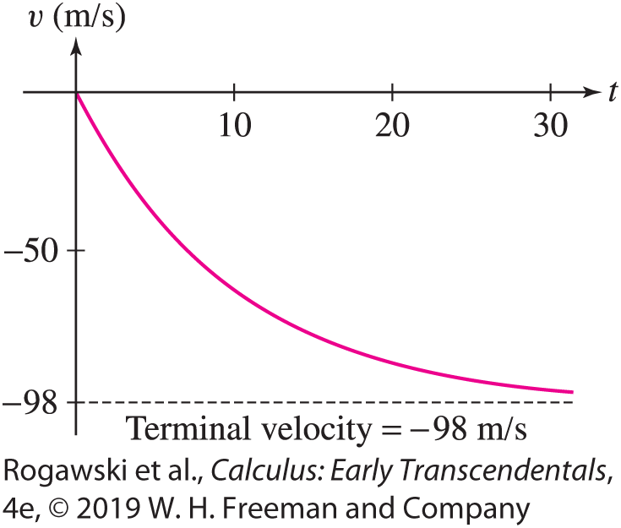
9.2 Models Involving $y′$ = k(y − b) (9 of 15)
b) With t in seconds, we have, by Eq. (4),
v(t) = −98 + Ce^{−(k/m)t} = −98 + Ce^{−(8/80)t} = −98 + Ce^{−0.1t}
We assume that the skydiver leaves the airplane with no initial vertical velocity, so
v(0) = −98 + C = 0, and C = 98. Thus, we have
v(t ) = −98(1 − e^{−0.1t} ) (Figure 3)
The skydiver’s velocity after 30 s is
v(30) = −98(1 − e^{−0.1(30)}) ≈ −93.1 m/s

Slide 34

9.2 Models Involving $y′$ = k(y − b) (10 of 15)
In Sections 2.5 and 4.5, we investigated limits involving the maximum height attained by a 1-kg ball that is launched upward at 30 m/s and acted on by gravity and air resistance. We observed that the maximum height (in meters) depends on the strength of the air resistance (i.e., on the proportionality constant k), a relationship given by
$$H\left(k\right)=\frac{30k−9.8\ln\left(\frac{150k}{49}+1\right)}{k^{2}}$$
Using Eq. (4), we can now derive this equation. In the next example, we find equations for the projectile’s velocity v(t) and height y(t). The maximum height H (k) is then found by determining the height when the velocity is zero (see Exercise 17).

Slide 35

9.2 Models Involving $y′$ = k(y − b) (11 of 15)
EXAMPLE: A 1-kg ball is launched from the ground at 30 m/s and is acted on by air resistance that is expressed in the form −kv and by gravity. Determine its velocity v(t) and height y(t).
Solution By Eq. (4), the projectile’s velocity is
$$v(t)=−\frac{9.8}{k}+Ce^{−kt}$$
where C must be chosen so that v(0) = 30. That is, C must satisfy 30 =$−\frac{9.8}{k}$ + C, equivalently $C=30+\frac{9.8}{k}$. Therefore,
$$v(t)=−\frac{9.8}{k}+\left(30+\frac{9.8}{k}\right)e^{−kt}$$

Slide 36

9.2 Models Involving $y′$ = k(y − b) (12 of 15)
Next, we take the antiderivative of v(t) to find y(t). We have
$$y(t)=−\frac{9.8}{k}t−\frac{1}{k}\left(30+\frac{9.8}{k}\right)e^{−kt}+D$$
To satisfy y(0) = 0, we must have $D=\frac{1}{k}\left(30+\frac{9.8}{k}\right)$. Using this equation to substitute, we have
$$y(t)=−\frac{9.8}{k}t+\frac{30k+9.8}{k^{2}}(1−e^{−kt})$$

Slide 37

9.2 Models Involving $y′$ = k(y − b) (13 of 15)
An annuity is an investment in which an amount of money P₀, called the principal, is placed in an account that earns interest. Let P(t) be the balance in the annuity (in dollars) after t years. When interest on the balance is compounded continuously at rate r, the rate of growth of the balance is proportional to the balance, and the proportionality constant is r. That is, $P′$(t) = r P(t). If we withdraw from the annuity at a constant rate of N dollars per year, we can model the balance in the annuity by the differential equation
$$P^{′}\left(t\right)=rP−N=r\left(P−\frac{N}{r}\right)$$
This equation has the form $y′$ = k(y − b) with k = r and b = N/r , so by Eq. (2), the general solution is
$$P\left(t\right)=\frac{N}{r}+e^{rt} (7)$$

Slide 38

9.2 Models Involving $y′$ = k(y − b) (14 of 15)
Since P(0) = P₀, we know P₀ = $\frac{N}{r}$+ C, and therefore C = P₀ − $\frac{N}{r}$ .
Because e^{rt} tends to infinity as t → ∞, the balance P(t) tends to ∞ if C > 0.
If C < 0, then P(t) tends to −∞ (i.e., the annuity eventually runs out of money). If C = 0, then P(t) remains constant with value N/r .
EXAMPLE: Does an Annuity Pay Out Forever? An annuity earns continuously compounded interest at the rate r = 0.07, and withdrawals are made continuously at a rate of N = $500/year.
When will the annuity run out of money if the initial deposit is P(0) = $5000?
Show that the balance increases indefinitely if P(0) = $9000.

Slide 39
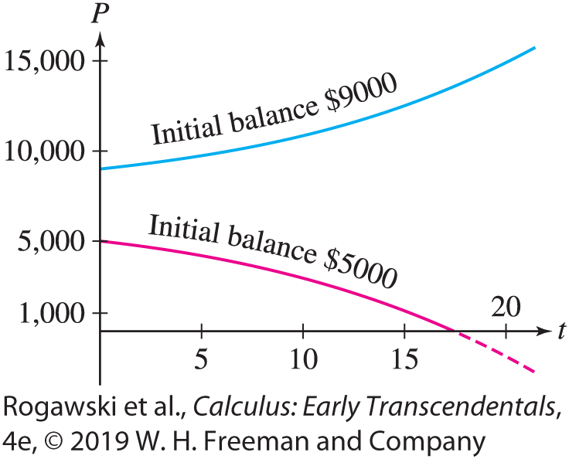

9.2 Models Involving $y′$ = k(y − b) (15 of 15)
Solution We have N/r = $\frac{500}{0.07}$ ≈ 7143, so P(t) = 7143 + C$e^{0.07t}e$by Eq. (7).
If P(0) = 5000 = 7143 + Ce⁰, then C = −2143 and P(t) = 7143 − 2143e ^{0.07t}. The account runs out of money when P(t) = 7143 − 2143e ^{0.07t} = 0, or $e^{0.07t}=\frac{7143}{2143}.$ So, $0.07t=\ln{\frac{7143}{2143}≈}1.2.$ The annuity money runs out at time t = $\frac{1.2}{0.07}$ ≈ 17 years.
If P(0) = 9000 = 7143 + Ce⁰, then C = 1857 and P(t) = 7143 + 1857e^{0.07t}. Since the coefficient C = 1857 is positive, the account never runs out of money. In fact, P(t) increases indefinitely as t → ∞. Figure 4 illustrates the two cases.

Slide 40

9.3 Graphical and Numerical Methods (1 of 16)
So far, we have focused on finding solutions to differential equations. Differential equations cannot always be solved explicitly. Fortunately, there are techniques for analyzing the solutions that do not rely on explicit formulas. Even for differential equations that have exact solutions, these techniques are valuable because they provide us with extra insight into the behavior of the solutions. This section discusses slope fields, which provide a good visual understanding of first-order equations. Euler’s Method allows finding numerical approximations to solutions.
With t as the independent variable, a first-order differential equation can then be written in the form
$$\frac{dy}{dt}=F\left(t,y\right) (1)$$
where F (t, y) is a function of t and y. The differential equation indicates that $\frac{dy}{dt}$ the slope of the graph of a solution y = y(t), at a point (t, y), is given by F (t, y).

Slide 41
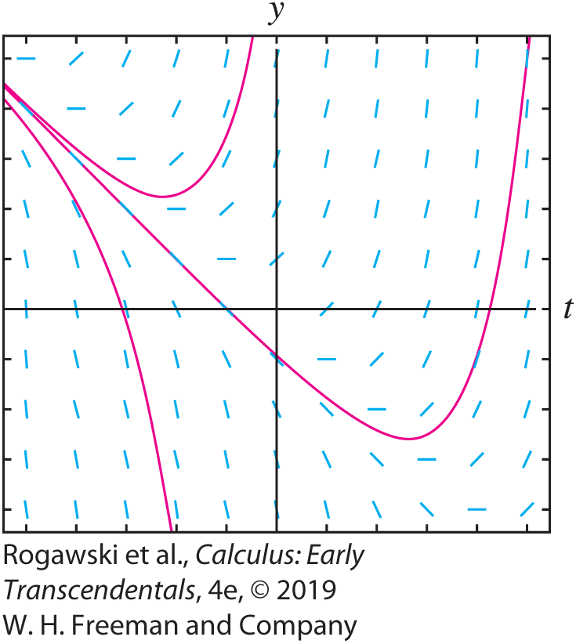

9.3 Graphical and Numerical Methods (2 of 16)
It is useful to think of Eq. (1) as a set of instructions that “tells a solution” which direction to go. Thus, a solution passing through a point (t, y) is “instructed” to do so in the direction of the slope F (t, y) since the differential equation requires F (t, y) to be the slope of the graph of the solution at that point.
To visualize this set of instructions, we draw a slope field, which is an array of small segments of slope F (t, y) at points (t, y) lying on a rectangular grid in the plane as in Figure 1.
Solutions to the differential equation $\frac{dy}{dt}=F\left(t,y\right)$ must have graphs that are everywhere tangent to the slope field, and therefore, without knowing the solutions, we can picture how their graphs must appear within the slope field.

Slide 42
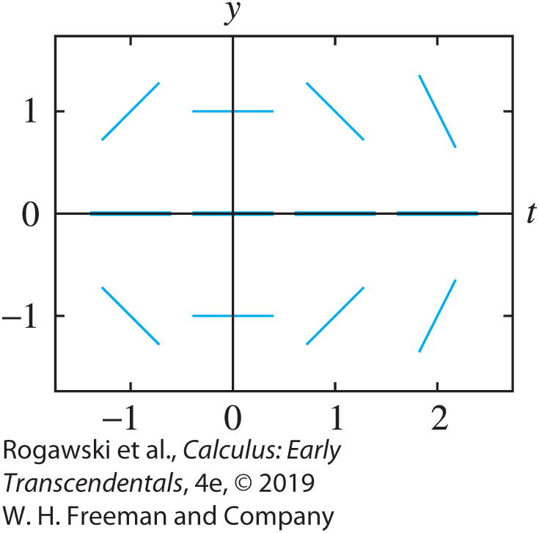

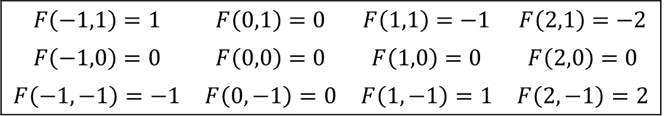

9.3 Graphical and Numerical Methods (3 of 16)
To illustrate, let’s consider the differential equation
$$\frac{dy}{dt}=−ty$$
In this case, F (t, y) = −ty. To sketch a slope field, we first compute F (t, y) for an array of points in the ty-plane:
Then at each point (t, y), plot a segment of slope F (t, y) as in Figure 2.
Values of $F(t,y)$
$$F\left(−1,1\right)=1$$ | $$F\left(0,1\right)=0$$ | $$F\left(1,1\right)=−1$$ | $$F\left(2,1\right)=−2$$
$$F\left(−1,0\right)=0$$ | $$F\left(0,0\right)=0$$ | $$F\left(1,0\right)=0$$ | $$F\left(2,0\right)=0$$
$$F\left(−1,−1\right)=−1$$ | $$F\left(0,−1\right)=0$$ | $$F\left(1,−1\right)=1$$ | $$F\left(2,−1\right)=2$$

Slide 43
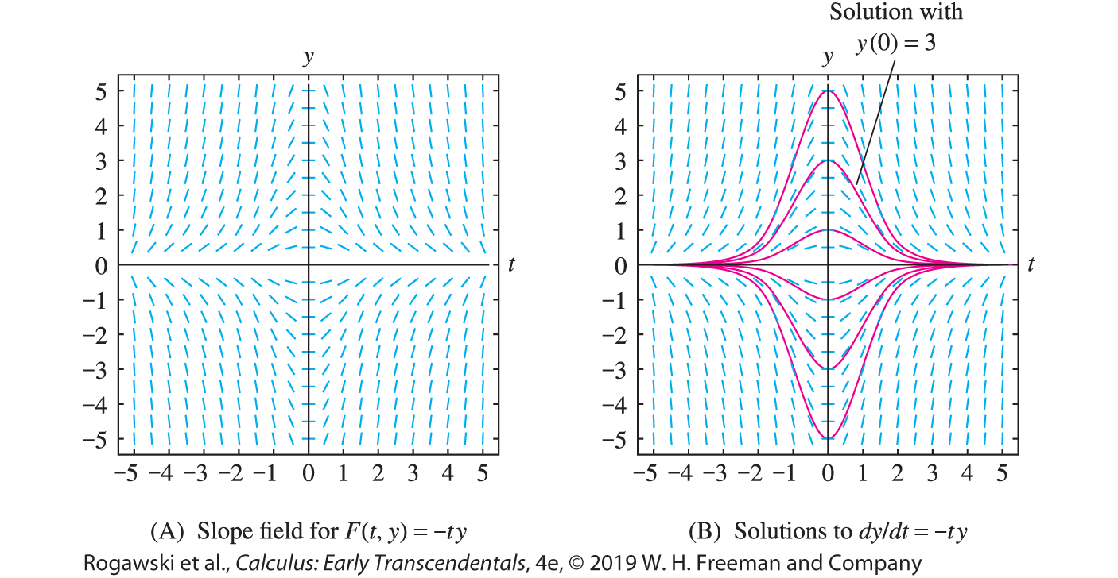

9.3 Graphical and Numerical Methods (4 of 16)
A slope field is much easier to generate using technology than by hand. Many graphing calculators and computer algebra systems can produce slope fields. There are online programs available as well. We used technology to generate the slope field for $\frac{dy}{dt}=−ty$ in Figure 3(A).
We can use the slope field to see how solutions appear. The slope field enables us to visualize many solutions at a glance. Starting at any point, and going both to the left and to the right from the point, we can sketch a solution by drawing a curve that runs tangent to the slope segments at each point [Figure 3(B)]. The graph of a solution is also called an integral curve.

Slide 44

9.3 Graphical and Numerical Methods (5 of 16)
EXAMPLE: Using Isoclines Draw the slope field for
$$\frac{dy}{dt}=y−t$$
and sketch the integral curves satisfying the initial conditions y(0) = 1 and y(1) = −2.
Solution A good way to sketch the slope field of $\frac{dy}{dt}=F(t,y)$ is to choose several values c and identify the curve F (t, y) = c, called the isocline of slope c. The isocline is the curve consisting of all points where the slope field has slope c.
In our case, F (t, y) = y − t, so the isocline of fixed slope c has equation y − t = c, or
y = t + c, which is a line. Consider the following values:

Slide 45
9.3 Graphical and Numerical Methods (6 of 16)
c = 0: This isocline is y − t = 0, or y = t. We draw segments of slope c = 0 at points along the line y = t, as in Figure 4(A).
c = 1: This isocline is y − t = 1, or y = t + 1. We draw segments of slope 1 at points along y = t + 1, as in Figure 4(B).
c = 2: This isocline is y − t = 2, or y = t + 2. We draw segments of slope 2 at points along y = t + 2, as in Figure 4(C).
c = −1: This isocline is y − t = −1, or y = t − 1 [Figure 4(C)].
A more detailed slope field is shown in Figure 4(D).
To sketch the solution satisfying y(0) = 1, begin at the point (t₀, y₀) = (0, 1) and draw the integral curve passing through (0, 1) that is everywhere tangent to the slope field. The solution satisfying y(1) = −2 is sketched similarly.
Figure 4(E) shows several other solutions.

Slide 46
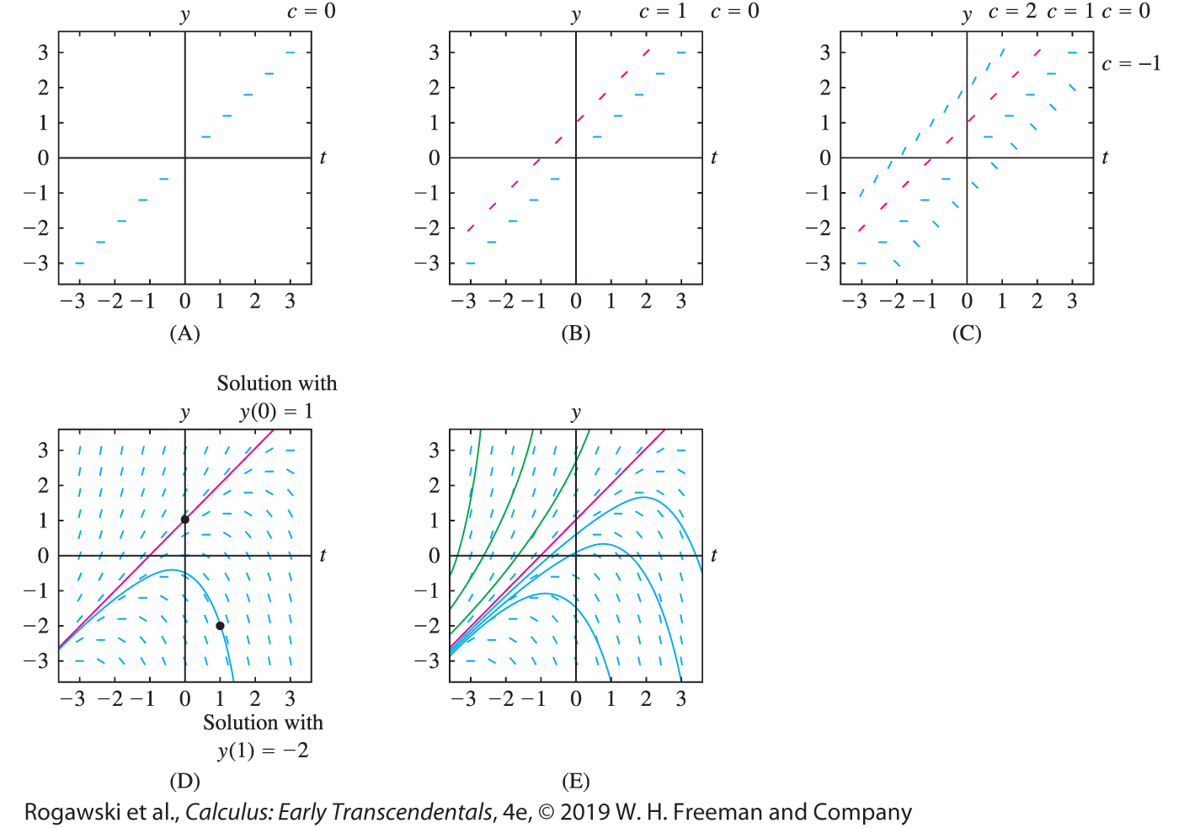
9.3 Graphical and Numerical Methods (7 of 16)

Slide 47
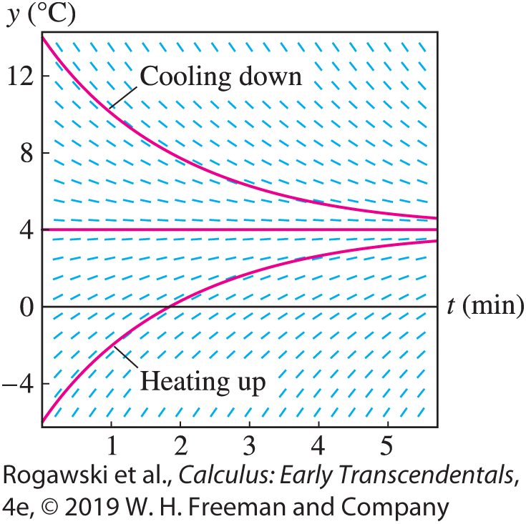

9.3 Graphical and Numerical Methods (8 of 16)
EXAMPLE: Newton’s Law of Cooling Revisited The temperature y(t) (in degrees Celsius) of an object placed in a refrigerator that is kept at 4°C satisfies $\frac{dy}{dt}$ = −0.5(y − 4) (t in minutes). Draw the slope field and describe the behavior of the solutions.
Solution The function F (t, y) = −0.5(y − 4) depends only on y, so slopes of the segments in the slope field do not vary in the t-direction. The slope F (t, y) is positive for y < 4 and negative for y > 4. More precisely, the slope at height y is −0.5(y − 4) = −0.5y + 2, so the segments grow steeper with positive slope as y → −∞, and they grow steeper with negative slope as y →∞ (Figure 5).

Slide 48
9.3 Graphical and Numerical Methods (9 of 16)
The slope field shows that if the initial temperature satisfies y₀ > 4, then y(t) decreases to y = 4 as t → ∞. In other words, the object cools down to 4°C when placed in the refrigerator.
If y₀ < 4, then y(t) increases to y = 4 as t → ∞. The object warms up when placed in the refrigerator.
If y₀ = 4, then y remains at 4°C for all time t .

Slide 49

9.3 Graphical and Numerical Methods (10 of 16)
Euler’s Method produces numerical approximations to the solution y(t) of a first-order Initial Value Problem:
$$\frac{dy}{dt}=F\left(t,y\right), y\left(t_{0}\right)=y_{0}$$
We begin by choosing a small number h, called the time step, and consider the sequence of times starting at the initial value t₀ and spaced at intervals of size h:
t₀, t₁ = t₀ + h, t₂ = t₀ + 2h, t₃ = t₀ + 3h, …
In general, t_{k} = t₀ + kh for k = 0, 1, 2, ... . Euler’s Method consists of computing a sequence of values y₁, y₂, y₃, ... , y_{n} successively using the formula
y_{k} = y_{k−1} + hF (t_{k−1}, y_{k−1})

Slide 50
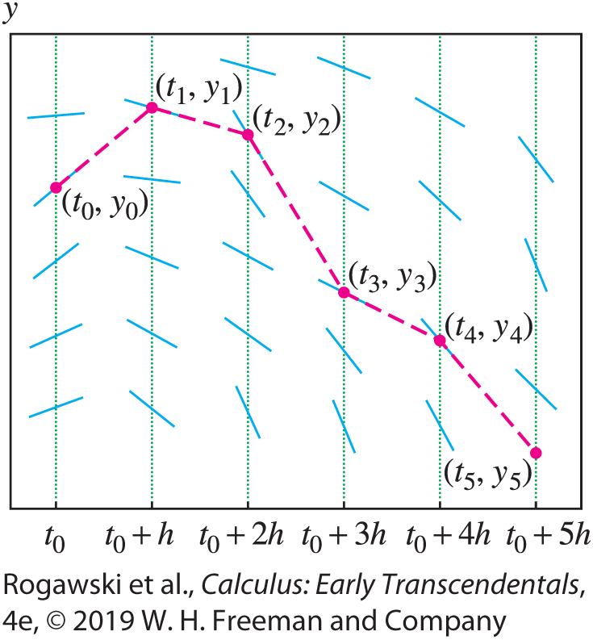
9.3 Graphical and Numerical Methods (11 of 16)
Each y_{k} is an approximation to the value of the solution to the Initial Value Problem at t_{k} ; that is, y_{k} ≈ y(t_{k} ). Starting with the initial value y₀ = y(t₀), we compute
y₁ = y₀ + hF (t₀, y₀), y₂ = y₁ + hF (t₁, y₁), etc.
We connect the points (t_{k} , y_{k} ) by segments to obtain an approximation to the graph of y(t) (Figure 7).

Slide 51

9.3 Graphical and Numerical Methods (12 of 16)
EXAMPLE: Use Euler’s Method with time step h = 0.2 and n = 4 steps to approximate the solution of $\frac{dy}{dt}=y−t^{2}$, y(0) = 3 at t = 0.2, 0.4, 0.6, and 0.8.
Solution Our initial value at t₀ = 0 is y₀ = 3. The time values are t₁ = 0.2, t₂ = 0.4,
t₃ = 0.6, and t₄ = 0.8. We use Eq. (3) with F (t , y) = y − t ² to calculate
y(0.2) ≈ y₁ = y₀ + hF (t₀, y₀) = 3 + 0.2(3 − (0)²) = 3.6
y(0.4) ≈ y₂ = y₁ + hF (t₁, y₁) = 3.6 + 0.2(3.6 − (0.2)²) ≈ 4.3
y(0.6) ≈ y₃ = y₂ + hF (t₂, y₂) = 4.3 + 0.2(4.3 − (0.4)²) ≈ 5.14
y(0.8) ≈ y₄ = y₃ + hF (t₃, y₃) = 5.14 + 0.2(5.14 − (0.6)²) ≈ 6.1

Slide 52
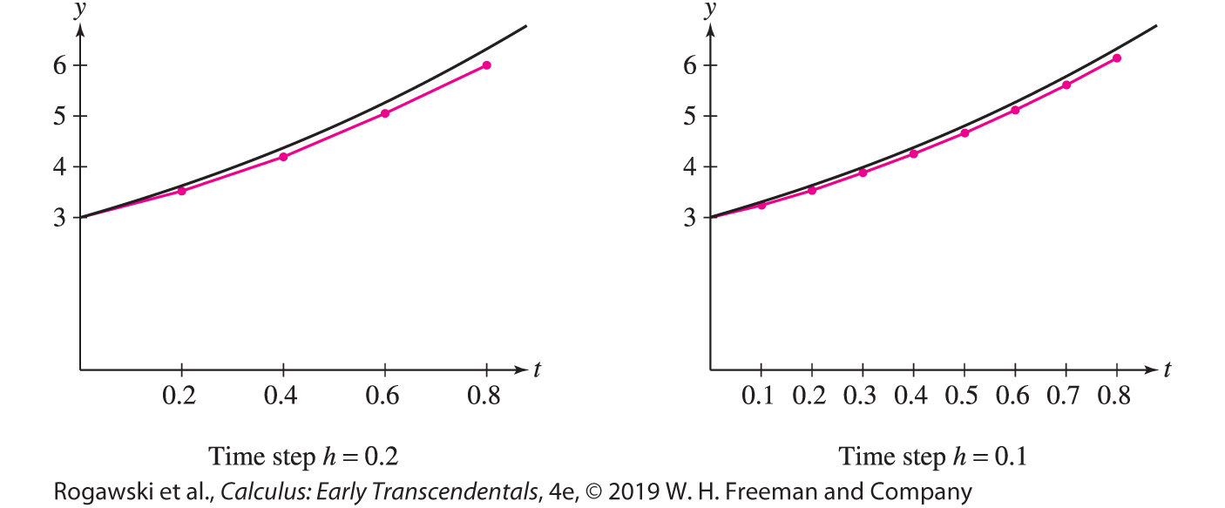
9.3 Graphical and Numerical Methods (13 of 16)
For comparison, Figure 8(A) shows the exact solution, y(t ) = 2 + 2t + t ² + e^{t} , to the Initial Value Problem in the previous example, together with a plot of the points (t_{k} , y_{k} ) for k = 0, 1, 2, 3, 4 connected by line segments.

Slide 53

9.3 Graphical and Numerical Methods (14 of 16)
EXAMPLE: Let y(t) be the solution of $\frac{dy}{dt}=$ sin t cos y, y(0) = 0.
Use Euler’s Method with time step h = 0.1 to approximate y(0.5).
Use a computer algebra system to implement Euler’s Method with time steps
h = 0.01, 0.001, and 0.0001 to approximate y(0.5).
Solution
a) When h = 0.1, y_{k} is an approximation to y(0 + k(0.1)) = y(0.1k), so y₅ is an approximation to y(0.5). It is convenient to organize calculations in the following table. Note that the value y_{k+1} computed in the last column of each line is used in the next line to continue the process.

Slide 54
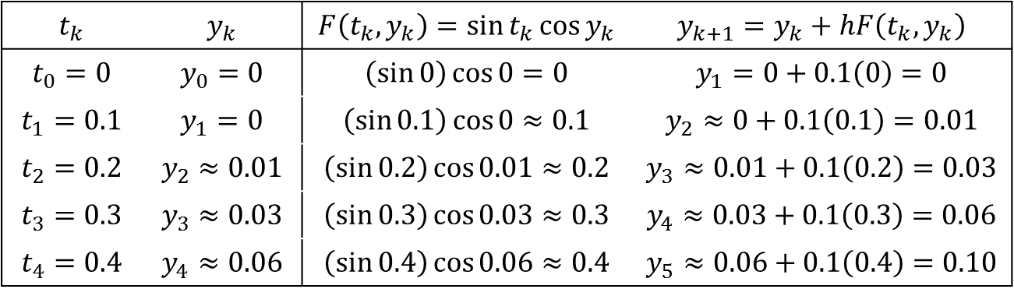
9.3 Graphical and Numerical Methods (15 of 16)
Thus, Euler’s Method yields the approximation y(0.5) ≈ y₅ ≈ 0.1.
$$t_{k}$$ | $$y_{k}$$ | $$F\left(t_{k},y_{k}\right)=\sin{t_{k}}\cos{y_{k}}$$ | $$y_{k+1}=y_{k}+hF\left(t_{k},y_{k}\right)$$
$$t_{0}=0$$ | $$y_{0}=0$$ | $$\left(\sin{0}\right)\cos{0}=0$$ | $$y_{1}=0+0.1\left(0\right)=0$$
$$t_{1}=0.1$$ | $$y_{1}=0$$ | $$\left(\sin{0.1}\right)\cos{0}≈0.1$$ | $$y_{2}≈0+0.1\left(0.1\right)=0.01$$
$$t_{2}=0.2$$ | $$y_{2}≈0.01$$ | $$\left(\sin{0.2}\right)\cos{0.01}≈0.2$$ | $$y_{3}≈0.01+0.1\left(0.2\right)=0.03$$
$$t_{3}=0.3$$ | $$y_{3}≈0.03$$ | $$\left(\sin{0.3}\right)\cos{0.03}≈0.3$$ | $$y_{4}≈0.03+0.1\left(0.3\right)=0.06$$
$$t_{4}=0.4$$ | $$y_{4}≈0.06$$ | $$\left(\sin{0.4}\right)\cos{0.06}≈0.4$$ | $$y_{5}≈0.06+0.1\left(0.4\right)=0.10$$

Slide 55
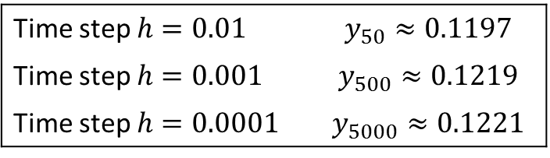
9.3 Graphical and Numerical Methods (16 of 16)
When the number of steps is large, the calculations are too lengthy to do by hand, but they are easily carried out using a CAS. Note that for h = 0.01, the kth value y_{k} is an approximation to y(0 + k(0.01)) = y(0.01k), and y₅₀ gives an approximation to y(0.5). Similarly, when
h = 0.001, y₅₀₀ is an approximation to y(0.5), and when h = 0.0001, y₅₀₀₀ is an approximation to y(0.5). Here are the results obtained using a CAS:
The values appear to converge and we may assume that y(0.5) ≈ 0.12. However, we see here that Euler’s Method converges quite slowly.
Time step $h=0.01$ | $$y_{50}≈0.1197$$
Time step $h=0.001$ | $$y_{500}≈0.1219$$
Time step $h=0.0001$ | $$y_{5000}≈0.1221$$

Slide 56
9.4 The Logistic Equation (1 of 11)
In Section 9.1, we introduced the population growth model dy/dt = ky. The solutions to this differential equation (with k > 0) imply that the population grows exponentially. Although such a growth model might be valid over an initial short time period, no population can increase without limit because many resources such as food and land are finite. To model a population subject to finite resources, we adjust the assumptions underlying the differential equation. If y(t) represents the population at time t and A denotes the maximum population that the environment can support, we let A − y(t) represent the room available for growth. Now we assume that
The rate of change of y is proportional to the amount y(t) present
and the amount A − y(t) of room for growth.

Slide 57
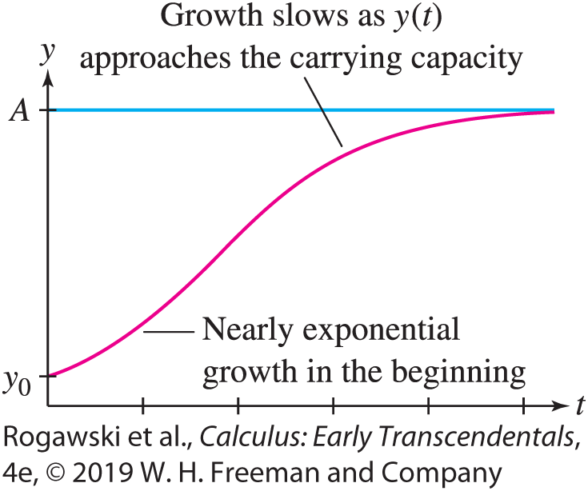

9.4 The Logistic Equation (2 of 11)
Translating this into a differential equation, we obtain the logistic differential equation
$$\frac{dy}{dt}=Ky\left(A−y\right) (1)$$
where K is a proportionality constant. For convenience, we slightly rewrite the right side:
$$Ky\left(A−y\right)=KyA\left(1−\frac{y}{A}\right)=ky(1−\frac{y}{A})$$
Here, we replaced the product of constant terms KA with constant k. Therefore, we have
$$\frac{dy}{dt}=ky(1−\frac{y}{A})$$
Here, k > 0 and is the growth constant, while A > 0
and is the carrying capacity. Figure 1 shows a typical
S-shaped solution of Eq. (1).

Slide 58
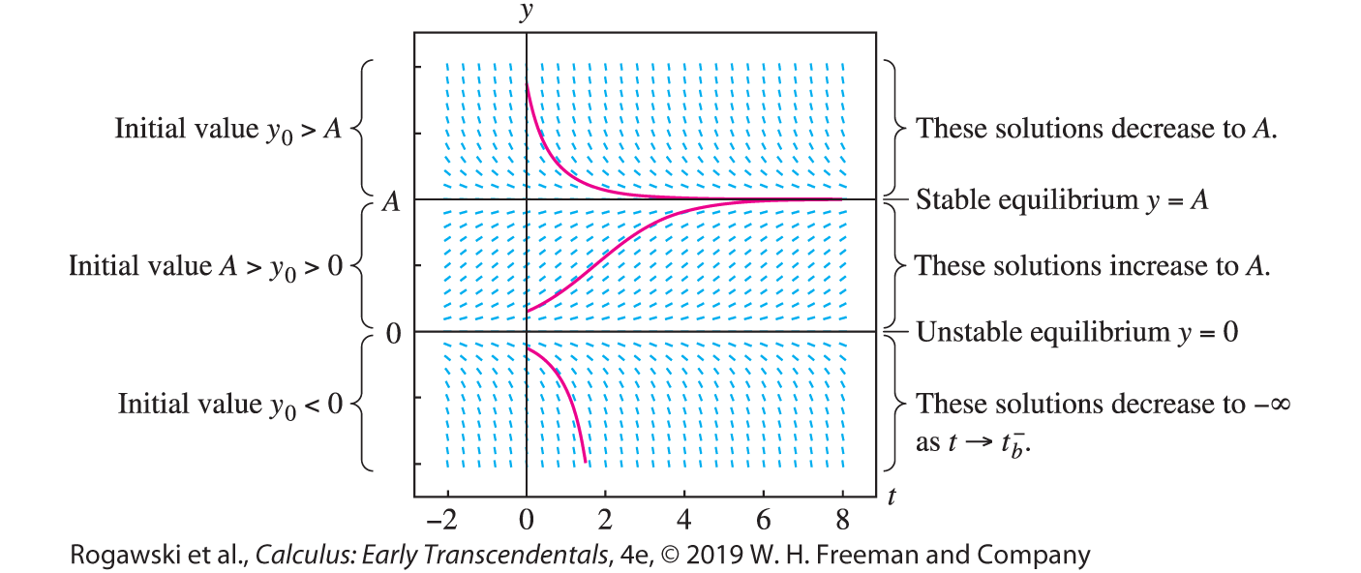

9.4 The Logistic Equation (3 of 11)
The slope field in Figure 2 shows clearly that there are three families of solutions, depending on the initial value y₀ = y(0).
If y₀ > A, then y(t ) is decreasing and approaches A as t → ∞.
If 0 < y₀ < A, then y(t ) is increasing and approaches A as t → ∞.
If y₀ < 0, then y(t ) is decreasing and $\lim_{t→t_{b}^{−}}{y\left(t\right)=−∞}$ for some time t_{b}.

Slide 59

9.4 The Logistic Equation (4 of 11)
Equation (1) also has two constant solutions: y = 0 and y = A. They correspond to the roots of ky(1 − y/A) = 0, and they satisfy Eq. (1) because $\frac{dy}{dt}$ = 0 when y is a constant. Constant solutions are called equilibrium or steady-state solutions.
The equilibrium solution y = A is a stable equilibrium because every solution with initial value y₀ close to A approaches the equilibrium $y=A$ as t → ∞.
By contrast, y = 0 is an unstable equilibrium because every nonequilibrium solution with initial value y₀ near y = 0 either increases to A or decreases to −∞. These nonequilibrium solutions deviate away from the unstable equilibrium solution as time moves forward.

Slide 60

9.4 The Logistic Equation (5 of 11)
Having described the solutions qualitatively, let us now find the nonequilibrium solutions explicitly using Separation of Variables. Assuming that y ≠ 0 and y ≠ A, we have
$$\frac{dy}{dt}=ky(1−\frac{y}{A})$$
$$\frac{dy}{y(1−\frac{y}{A}) }=kdt$$
$$\int{\left(\frac{1}{y}−\frac{1}{y−A}\right)dy}=\int{kdt}$$
ln |y|− ln |y − A|= kt + C
Hence, we obtain $\frac{y}{y−A}=Be^{kt}$ (3) because B can be both positive and negative.

Slide 61

9.4 The Logistic Equation (6 of 11)
For t = 0, this gives a useful relation between B and the initial value y₀ = y(0):
$$\frac{y_{0}}{y_{0}−A}=B (4)$$
To solve for y, multiply each side of Eq. (3) by (y − A):
y = (y − A)Be^{kt} and y(1 − Be^{kt} ) = − ABe^{kt}
$$y=−\frac{ABe^{kt}}{1−Be^{kt}}$$
Since $B≠0 ,$we obtain the general nonequilibrium solution
$$y=\frac{A}{1−{e^{−kt}}/B} for \frac{dy}{dt}=ky\left(1−\frac{y}{A}\right) (5)$$

Slide 62

9.4 The Logistic Equation (7 of 11)
We use this formula in the next two examples. In each case, the differential equation may instead be solved by Separation of Variables, the method used to derive this solution.
EXAMPLE: Solve $\frac{dy}{dt}$ = 0.3y(4 − y) with initial condition y(0) = 1.
Solution To apply Eq. (5), we must rewrite the equation in the form
$\frac{dy}{dt}=1.2y\left(1−\frac{y}{4}\right).$Thus, k = 1.2 and A = 4, and the general solution is
$$y=\frac{4}{1−{e^{−1.2t}}/B}$$

Slide 63
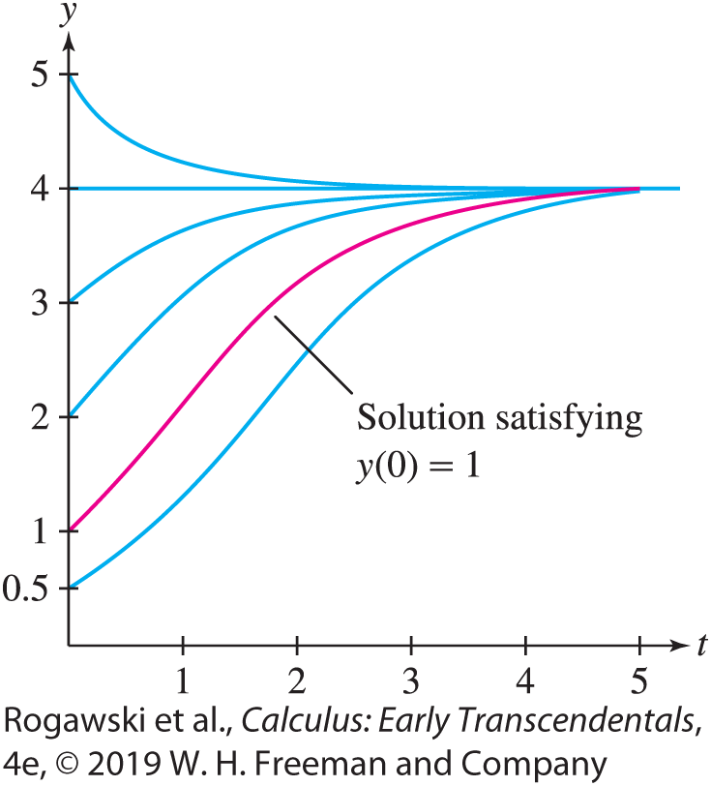

9.4 The Logistic Equation (8 of 11)
There are two ways to find B. One way is to solve y(0) = 1 for B directly. An easier way is to use Eq. (4):
$$B=\frac{y_{0}}{y_{0}−A}=\frac{1}{1−4}=−\frac{1}{3}$$
We find that the particular solution is $y=\frac{4}{1 + 3e^{−1.2t}}$ (Figure 3)

Slide 64

9.4 The Logistic Equation (9 of 11)
EXAMPLE: Deer Population A deer population grows logistically with growth constant k = 0.4 year⁻¹ in a forest with a carrying capacity of 1000 deer.
Find the deer population P(t) if the initial population is P₀ = 100.
How long does it take for the deer population to reach 500?
Solution The time unit is the year because the unit of k is year⁻¹.
a) Since k = 0.4 and A = 1000, P(t) satisfies the differential equation
$$\frac{dP}{dt}=0.4P\left(1−\frac{P}{1000}\right)$$
The general solution is given by Eq. (5):
$$P=\frac{1000}{1−{e^{−0.4t}}/B}$$

Slide 65
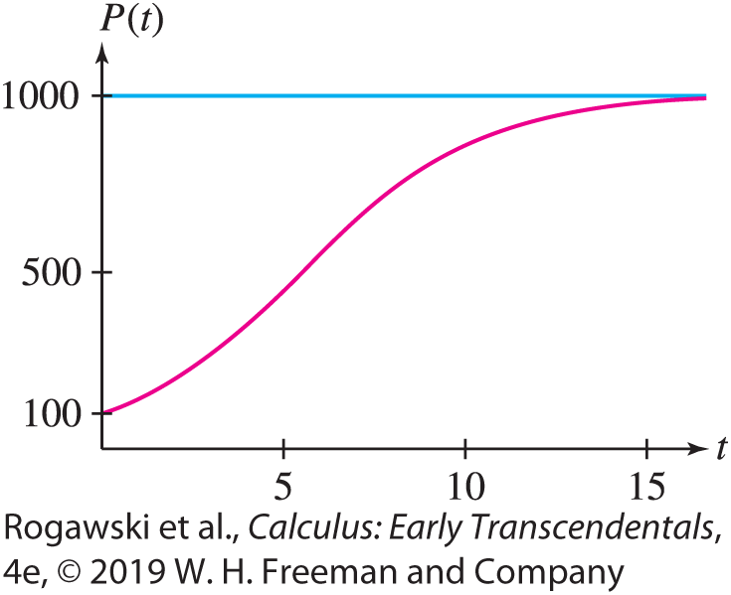

9.4 The Logistic Equation (10 of 11)
Using Eq. (4) to compute B, we find (Figure 4)
$$B=\frac{P_{0}}{P_{0}−A}=\frac{100}{100−1000}=−\frac{1}{9}$$
$$P(t)=\frac{1000}{1+9e^{−0.4t}}$$

Slide 66

9.4 The Logistic Equation (11 of 11)
To find the time t when P(t ) = 500, we could solve the equation $P(t)=\frac{1000}{1 + 9e^{−0.4t}}=500.$ But it is easier to use Eq. (3):
$$\frac{P}{P−A}=Be^{kt}, that is, \frac{500}{500−1000}=−\frac{1}{9}e^{0.4t}$$
Hence, $−\frac{1}{9}e^{0.4t}=−1.$ Thus, $e^{0.4t}=9,$ and $t=\frac{\ln{9}}{0.04}≈5.5 years.$

Slide 67
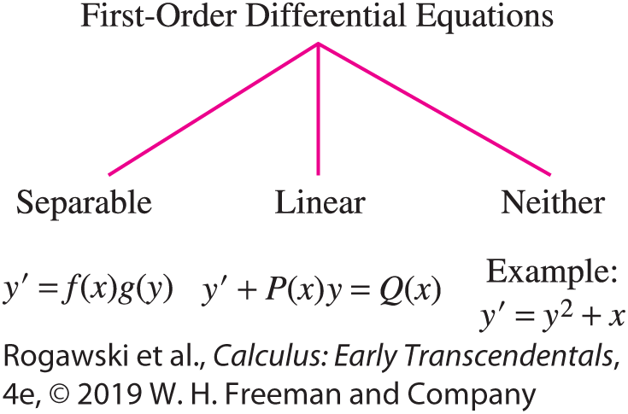

9.5 First-Order Linear Equations (1 of 15)
In Section 9.2, we investigated the first-order linear constant coefficient differential equation $\frac{dy}{dx}=ky+c$. In this section, we work with a more general version of this differential equation, where the terms k and c are functions of the independent variable (which here is x). The method of “integrating factors” is used to solve these differential equations. Although some of these equations are separable and can be solved by separation of variables, the method that we present here applies to all first-order linear differential equations, whether separable or not (Figure 1).
A first-order linear differential equation
is one that can be put in the following form:
$y^{′}+P\left(x\right)y=Q\left(x\right) (1)$

Slide 68

9.5 First-Order Linear Equations (2 of 15)
To solve Eq. (1), we shall multiply through by a function α(x), called an integrating factor, that turns the left-hand side into the derivative of α(x)y:
$$α\left(x\right)y^{′}+α\left(x\right)P\left(x\right)y={\left(α\left(x\right)y\right)}^{′} (2)$$
Suppose we can find α(x ) satisfying Eq. (2) that is nonzero. Then Eq. (1) yields
$$α\left(x\right)y^{′}+α\left(x\right)P\left(x\right)y=α\left(x\right)Q(x)$$
$${\left(α\left(x\right)y\right)}^{′}=α\left(x\right)Q(x)$$
We can solve this equation by integration:
$$α\left(x\right)y=\int{α\left(x\right)Q(x) dx} or y=\frac{1}{α(x)}\int{α\left(x\right)Q(x) dx}$$

Slide 69

9.5 First-Order Linear Equations (3 of 15)
To find α(x ), expand Eq. (2), using the Product Rule on the right-hand side:
α(x)$y′$ + α(x) P(x)y = α(x)$y′$ + α’ (x)y, which simplifies to α(x) P(x)y = $α′$(x)y.
Dividing by y, we obtain
$$\frac{dα}{dx}=P\left(x\right)α\left(x\right)$$
We solve this equation using Separation of Variables:
$$\frac{dα}{α(x)}=P\left(x\right)dx or \ln\left|α\right|=\int{\frac{dα}{α(x)}}=\int{P\left(x\right)dx}$$
$$α={±e}^{\int{P\left(x\right)dx}}$$
Since we need just one solution, we choose the expression with positive sign for α(x).

Slide 70

9.5 First-Order Linear Equations (4 of 15)
THEOREM:
The general solution of $y′$ + P(x)y = Q(x) is
$$y=\frac{1}{α(x)}\int{α\left(x\right)Q(x) dx}$$
where α(x) is an integrating factor:
$$α=e^{\int{P\left(x\right)dx}}$$

Slide 71

9.5 First-Order Linear Equations (5 of 15)
To solve differential equations $y′$ + P(x)y = Q(x), we can either find an integrating factor and use Eq. (4) in Theorem 1, or we can use the method that yielded the solution in Eq. (4). That method is
Find an integrating factor $α=e^{\int{P\left(x\right)dx}}$.
Multiply both sides of the equation $y′$ + P(x)y = Q(x) by the integrating factor α(x). As a result, the left side of the equation is then the derivative of a product.
Integrate both sides and solve for y to obtain the solution.
We follow this method to obtain the solution in the next example.

Slide 72

9.5 First-Order Linear Equations (6 of 15)
EXAMPLE: Solve x$y′$ − 3y = x ², y(1) = 2.
Solution First, divide by x to put the equation in the form $y′$ + P(x)y = Q(x):
$$y^{′}+\frac{−3}{x}y=x$$
Thus, P(x) = −3x ⁻¹ and Q(x) = x .
Step 1. Find an integrating factor.
In our case, P(x) = −3x ⁻¹, and we obtain
$$α\left(x\right)=e^{\int{P(x)}dx}=e^{−3\int{\frac{dx}{x}}}=e^{−3\ln{x}}=x^{−3}$$
by Eq. (5).

Slide 73

9.5 First-Order Linear Equations (7 of 15)
Step 2. Multiply the equation by the integrating factor.
$$x^{−3}\left(y^{′}−\frac{3}{x}y\right)=x^{−3}x$$
$${\left(x^{−3}y\right)}^{′}=x^{−2}$$
Step 3. Integrate both sides: x ⁻³ y = −x ⁻¹ + C
Step 4. Solve for y: $y={−x}^{2}+Cx^{3}$
Step 5. Solve the Initial Value Problem.
Now solve for C using the initial condition y(1) = 2:
$$2=−1+C or C=3$$
Therefore, the solution of the Initial Value Problem is $y=−x^{2}+3x^{3}.$

Slide 74

9.5 First-Order Linear Equations (8 of 15)
Finally, let’s check that y = − x ² + 3x ³ satisfies our equation x$y′$ − 3y = x ²:
$xy^{′}$− 3y = x (−2x + 9x ²) − 3(−x ² + 3x ³)
= (−2x ² + 9x ³) + (3x ² − 9x ³) = x ²

Slide 75

9.5 First-Order Linear Equations (9 of 15)
EXAMPLE: Solve the Initial Value Problem: $y′$ + (1 − x ⁻¹)y = x ², y(1) = 2.
Solution This equation has the form $y′$ + P(x)y = Q(x) with P(x) = (1 − x ⁻¹). By Eq. (5), an integrating factor is
$$α\left(x\right)=e^{\int{\left(1−x^{−1}\right)dx}}=e^{x−\ln{x}}=e^{x}x^{−1}$$
By either multiplying by the integration factor and then integrating both sides of the resulting equation or by applying Eq. (4) with Q(x) = x ², we obtain the general solution:
$$y=\frac{1}{α(x)}\int{α\left(x\right)Q\left(x\right)dx}=xe^{−1}\int{e^{x}x^{−1}x^{2}dx}=xe^{−1}\int{xe^{x}dx}$$
Integration by Parts shows that $\int{xe^{x}dx}$= (x − 1)e^{x} + C, so we obtain
$$y=\left[xe^{−x}\left(x−1\right)e^{x}+C\right]=x\left(x−1\right)+Cxe^{−x}$$

Slide 76

9.5 First-Order Linear Equations (10 of 15)
The initial condition y(1) = 2 gives
y(1) = 1(1 − 1) + Ce⁻¹ = Ce⁻¹ = 2 or C = 2e
The desired particular solution is
$$y=x\left(x−1\right)+2exe^{−x}=x\left(x−1\right)+2xe^{1−x}$$

Slide 77
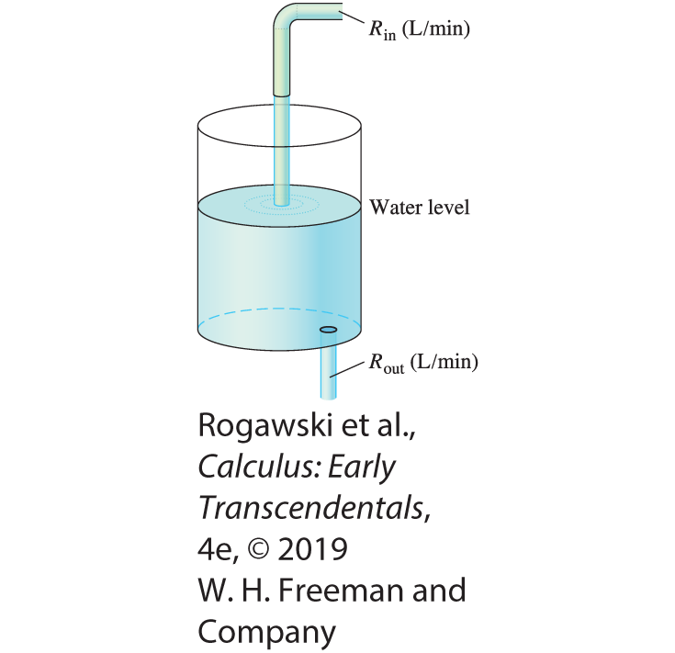
9.5 First-Order Linear Equations (11 of 15)
In the next example, we use a differential equation to model a “mixing problem,” which has applications in biology, chemistry, and medicine.
EXAMPLE: A Mixing Problem A tank contains 600 liters of water with a sucrose concentration of 0.2 kg/L. We begin adding water with a sucrose concentration of
0.1 kg/L at a rate of R_{in} = 40 L/min (Figure 3). The water mixes instantaneously and exits the bottom of the tank at a rate of R_{out} = 20 L/min. Let y(t) be the quantity (in kilograms) of sucrose in the tank at time t (in minutes). Set up a differential equation for y(t) and solve for y(t).

Slide 78

9.5 First-Order Linear Equations (12 of 15)
Solution
Step 1. Set up the differential equation.
The derivative dy/dt is the difference of two rates of change, namely the rate at which sucrose enters the tank and the rate at which it leaves:
$$\frac{dy}{dt}=sucrose rate in − sucrose rate out (6)$$
The rate at which sucrose enters the tank is sucrose rate in = (0.1 kg/L)(40 L/min) = 4 kg/min.
Next, we compute the sucrose concentration in the tank at time t. Water flows in at 40 L/min and out at 20 L/min, so there is a net inflow of 20 L/min. The tank has 600 L at time t = 0, so it has 600 + 20t L at time t, and
$$concentration at time t =\frac{kilograms of sucrose in tank}{liters of water in tank}=\frac{y(t)}{\text{60}\text{0} \text{+} \text{20}\text{t}} kg/L$$

Slide 79

9.5 First-Order Linear Equations (13 of 15)
The rate at which sucrose leaves the tank is the product of the concentration and the rate at which water flows out:
$$sucrose rate out =\frac{y(t)}{\text{60}\text{0} \text{+} \text{20}\text{t}}\frac{kg}{L}20\frac{L}{min}=\frac{20y(t)}{600+20t}\frac{kg}{L}=\frac{y(t)}{30+t}\frac{kg}{L}$$
Now, Eq. (6) gives us the differential equation
$$\frac{dy}{dt}=4−\frac{y}{30+t}$$
Step 2. Find the general solution.
We write the last equation in standard form:
$$\frac{dy}{dt}+\frac{1}{t+30}y=4$$

Slide 80

9.5 First-Order Linear Equations (14 of 15)
An integrating factor is
$$α\left(t\right)=e^{\int{P\left(t\right)dt}}=e^{\int{{(t+30)}^{−1}dt}}=e^{\ln{(t+30)}}=t+30$$
The general solution is
$$y(t)=\frac{1}{α(t)}\int{α\left(t\right)Q\left(t\right)dt}=\frac{1}{t+30}\int{4\left(t+30\right)dt}$$
$$=\frac{1}{t+30}\left(2{(t+30)}^{2}+C\right)=2t+60+\frac{C}{t+30}$$

Slide 81

9.5 First-Order Linear Equations (15 of 15)
Step 3. Solve the Initial Value Problem.
At t = 0, the tank contains 600 L of water with a sucrose concentration of 0.2 kg/L. Thus, the total sucrose at t = 0 is y(0) = (600)(0.2) = 120 kg. Also, from the general solution formula, we have
$$y\left(0\right)=60+\frac{C}{30}, and hence 120=60+\frac{C}{30}$$
Therefore, C = 1800, and we obtain the following formula (t in minutes), which is valid until the tank overflows:
$$y\left(t\right)=2t+60+\frac{1800}{t+30}kg of sucrose$$

